Slide 1
String Operations
TIP101
Notes:
🌟 Purpose: Welcome students and introduce the session's focus on string operations.
✅ What should I be doing?
Set a positive and engaging tone for the session.
Highlight the importance of mastering string operations.
🎙️ What should I be saying?
Welcome to Week 3, Session 1 of TIP101! Today, we’ll dive into string operations, a fundamental concept in Python that’s essential for solving many coding challenges.
By the end of today, you’ll feel confident working with strings, whether it’s slicing, formatting, or leveraging useful methods.
🙌🏽 How should I engage students?
Ask: "What’s one thing you’ve found useful or challenging about working with strings so far?"

Slide 2
1 | Welcome 👋🏽 | 10 minutes
2 | String Operations | 35 minutes
3 | BREAK | 5 minutes
4 | Collaborative Problem Solving | 60 minutes
5 | Wrap Up | 10 minutes
Notes:
🌟 Purpose: Outline the structure of the session and set expectations.
✅ What should I be doing?
Walk through the session’s schedule and ensure clarity on the goals.
🎙️ What should I be saying?
Here’s today’s agenda: We’ll start by exploring string operations, take a short break, and then practice solving problems collaboratively. We’ll wrap up with reflections and reminders.
The focus is on building both foundational knowledge and problem-solving skills.
🙌🏽 How should I engage students?
Pause for questions about the agenda and ask: "Is there anything you’re particularly looking forward to today?"

Slide 3
Welcome! 👋🏽
10 minutes

Slide 4


Turn on your cameras
Fill out the entry ticket
Notes:
🌟 Purpose: Encourage visual engagement to foster connection during the session.
✅ What should I be doing?
Prompt students to enable their cameras and submit the entry ticket.
🎙️ What should I be saying?
Let’s kick off our session by turning on our cameras!
Also, don’t forget to fill out the entry ticket to help us organize breakout rooms later.
🙌🏽 How should I engage students?
Use humor or compliments: "Let’s see those smiles!"
Acknowledge and thank students who turn on their cameras.

Slide 5
5 minutes
🎲Question:
What is one game you always feel confident about winning? (board game, card game, part game, video game, etc?).
💬Answer:
Share your answer in the Zoom chat below. Multiple options are encouraged.

Slide 6
Students report feeling supported by classmates during breakout rooms
Dictionaries went well
- Issues with visibility with screen sharing code (zoom in, try VS Code Live)
- Wanted more details on built in functionalities.
Notes:
🌟 Purpose: Share feedback from the previous session and highlight areas of success and improvement.
✅ What should I be doing?
Summarize feedback from the previous session's survey and present key takeaways.
🎙️ What should I be saying?
From your feedback, it seems many of you enjoyed [highlighted aspect]. One suggestion was [area for improvement]. We’ll work on that today.
🙌🏽 How should I engage students?
Ask: "Does anyone have additional feedback or suggestions?"

Slide 7

Announcements & Reminders
Assessment Reminder:
Fix it garage sessions ended for now (onboarding specific to errors relating to VS Code, the course portal, Slack, etc.)
Study hall sessions will remain active !
Utilize VS Code debugging functionalities.
Notes:
🌟 Purpose: purpose
✅ What should I be doing?
Stuff
🎙️ What should I be saying?
Stuff
🙌🏽 How should I engage students?
stuff

Slide 8
Strings in Python
35 minutes

Slide 9
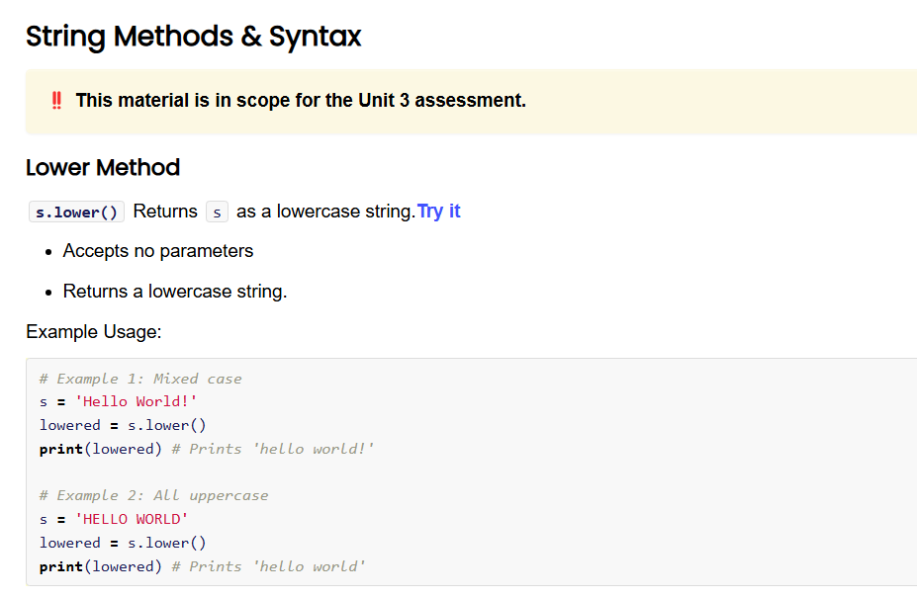
5 minutes
Open the Unit 3 Cheat Sheet and find String Methods & Syntax.
What do you notice?
What do you wonder?
Notes:
🌟 Purpose: Encourage students to explore the Unit 3 Cheat Sheet and identify key concepts and questions about string methods.
✅ What should I be doing?
Facilitate exploration of the cheat sheet and prompt students to think critically about string operations.
🎙️ What should I be saying?
Let’s take a moment to open the Unit 3 Cheat Sheet and look at the section on String Methods & Syntax. What do you notice? What do you wonder?
This is a great resource for understanding the wide range of operations you can perform on strings. Let’s identify anything that looks unfamiliar or particularly interesting.
🙌🏽 How should I engage students?
Ask: "Does anything surprise you about these methods? Are there any you’ve used before that you find especially helpful?"

Slide 10
String Basics
Strings are sequences of characters.
Common operations: concatenation, slicing, and formatting.
Useful methods: .lower(), .upper(), .split().
s = "Hello World"
print(s.lower()) # "hello world"
print(s[:5]) # "Hello"
Notes:
🌟 Purpose: Introduce key properties of strings and common operations.
✅ What should I be doing?
Use examples to explain string immutability, slicing, and formatting.
🎙️ What should I be saying?
Strings are sequences of characters, and they’re immutable, meaning you can’t change them directly. Think of them like sentences written in pen—you can rewrite them, but you can’t erase specific parts.
Some common operations include concatenation, slicing, and using methods like .lower() and .split(). For example, in the string s = 'Hello World', calling s.lower() will return 'hello world'.
Let’s try slicing—what do you think s[:5] will return?
🙌🏽 How should I engage students?
Ask: "Can someone explain why slicing is useful? How might you use it in a coding challenge?"

Slide 11
String Concatenation
Strings can be built by simply adding them together. This allows you to convert or modify existing text (filtering, encrypting, etc.)
Concatenation refers to using the “+” modifier to combine two or more strings together.
a = “Hello”
b = “World”
c = a + “ [Middle Segment] ” + b
Notes:
🌟 Purpose: Introduce key properties of strings and common operations.
✅ What should I be doing?
Use examples to explain string immutability, slicing, and formatting.
🎙️ What should I be saying?
Strings are sequences of characters, and they’re immutable, meaning you can’t change them directly. Think of them like sentences written in pen—you can rewrite them, but you can’t erase specific parts.
Some common operations include concatenation, slicing, and using methods like .lower() and .split(). For example, in the string s = 'Hello World', calling s.lower() will return 'hello world'.
Let’s try slicing—what do you think s[:5] will return?
🙌🏽 How should I engage students?
Ask: "Can someone explain why slicing is useful? How might you use it in a coding challenge?"

Slide 12
String Slicing
Returns a snippet or portion of a string, based on the provided indices.
Can provide either the beginning, or the ending index.
value = exampleString[:5]
value = exampleString[4:]
value = exampleString[2:8]
value = exampleString[0:10:2] #optional “step” value.
Notes:
🌟 Purpose: Introduce key properties of strings and common operations.
✅ What should I be doing?
Use examples to explain string immutability, slicing, and formatting.
🎙️ What should I be saying?
Strings are sequences of characters, and they’re immutable, meaning you can’t change them directly. Think of them like sentences written in pen—you can rewrite them, but you can’t erase specific parts.
Some common operations include concatenation, slicing, and using methods like .lower() and .split(). For example, in the string s = 'Hello World', calling s.lower() will return 'hello world'.
Let’s try slicing—what do you think s[:5] will return?
🙌🏽 How should I engage students?
Ask: "Can someone explain why slicing is useful? How might you use it in a coding challenge?"

Slide 13
2 minutes
What do you think happens if we try to modify a string in place? Please answer in the Zoom.
# Which section below is correct?
# Option A
s = "Hello World"
s = s.upper()
# Option B
s = "Hello World"
s.upper()
Notes:
🌟 Purpose: Reinforce the concept of string immutability through a discussion.
✅ What should I be doing?
Facilitate a short discussion to deepen understanding.
🎙️ What should I be saying?
Strings in Python are immutable, meaning we can’t modify them directly. If we want to change a string, we need to create a new one.
What do you think happens if we try to modify a string in place, like changing one of its characters?
This behavior is important to understand when working with strings in larger programs.
🙌🏽 How should I engage students?
Ask: "Can someone share a time when string immutability caused unexpected behavior in their code? How did you handle it?"

Slide 14
2 minutes
What do you think happens if we try to modify a string in place? Please answer in the Zoom.
# Which section below is correct?
# Option A ( CORRECT )
s = "Hello World"
s = s.upper()
# Option B
s = "Hello World"
s.upper()
Notes:
🌟 Purpose: Reinforce the concept of string immutability through a discussion.
✅ What should I be doing?
Facilitate a short discussion to deepen understanding.
🎙️ What should I be saying?
Strings in Python are immutable, meaning we can’t modify them directly. If we want to change a string, we need to create a new one.
What do you think happens if we try to modify a string in place, like changing one of its characters?
This behavior is important to understand when working with strings in larger programs.
🙌🏽 How should I engage students?
Ask: "Can someone share a time when string immutability caused unexpected behavior in their code? How did you handle it?"

Slide 15
10 minutes
Let's explore . . .
How to retrieve specific characters or substrings
Common transformations (e.g., upper(), replace(), split())
Notes:
🌟 Purpose: Demonstrate string manipulation techniques and highlight practical use cases.
✅ What should I be doing?
Use live coding to show how to manipulate and analyze strings.
🎙️ What should I be saying?
Let’s explore some common string operations. We’ll start with simple tasks like accessing characters and slicing, then move to transformations like converting to uppercase or splitting strings.
For example, if we have name = 'hello world', we can slice it to get the first five characters with name[:5] or transform it with name.upper() to get 'HELLO WORLD'.
Normalize Mistakes: Intentionally make an error, such as using incorrect slicing syntax, and debug it together.
Oops, it looks like I got an error here. Let’s debug this—why do you think this happened?
🙌🏽 How should I engage students?
Ask: "What’s another operation you’d like to see? Are there any methods in the cheat sheet that you’d like to try?"
Sample demo code
# Demonstrating common string operations
# 1. Initializing strings
name = "hello world"
print("Original string:", name)
# 2. Accessing characters
print("First character:", name[0])
print("Last character:", name[-1])
# 3. Slicing strings
print("First five characters:", name[:5])
print("Characters from index 6 onwards:", name[6:])
# 4. String length
print("Length of the string:", len(name))
# 5. String methods
print("Uppercase:", name.upper())
print("Lowercase:", name.lower())
print("Title case:", name.title())
print("Replacing 'world' with 'Python':", name.replace("world", "Python"))
# 6. Checking substrings
print("Does the string contain 'hello'?", "hello" in name)
print("Does the string start with 'hello'?", name.startswith("hello"))
print("Does the string end with 'world'?", name.endswith("world"))
# 7. Splitting and joining
words = name.split() # Splitting into a list of words
print("Split into words:", words)
joined = " ".join(words) # Joining the words back into a string
print("Joined back into a string:", joined)
# 8. Removing whitespace
name_with_spaces = " hello world "
print("String with spaces:", f"'{name_with_spaces}'")
print("String with leading and trailing spaces removed:", f"'{name_with_spaces.strip()}'")
# 9. String concatenation
greeting = "Hello"
target = "Python"
print("Concatenated string:", greeting + " " + target)
🌟 Purpose: purpose
✅ What should I be doing?
Stuff
🎙️ What should I be saying?
Stuff
🙌🏽 How should I engage students?
stuff

Slide 16
A pangram is a sentence that contains every letter of the English alphabet at least once, regardless of case. Write a function to determine if a given sentence is a pangram.
def is_pangram(sentence):
pass
Input: sentence = "The quick brown fox jumps over the lazy dog"
Output: True
Notes:
🌟 Purpose: Demonstrate solving a coding problem using the UMPIRE strategy, emphasizing problem understanding, planning, implementation, and debugging.
✅ What should I be doing?
Guide students step-by-step through solving the problem of determining if a sentence is a pangram.
Showcase how to use Python string methods and data structures effectively.
Incorporate interactivity and normalize mistakes to reinforce debugging as a natural part of problem-solving.
🎙️ What should I be saying?
1. Understand the Problem
"Let’s start with the first step of UMPIRE—Understand. A pangram is a sentence that contains every letter of the English alphabet at least once, regardless of case."
"For example, the sentence 'The quick brown fox jumps over the lazy dog' is a pangram because it includes all 26 letters."
"Our task is to write a function is_pangram that takes a sentence as input and returns True if it’s a pangram and False otherwise."
Ask Students: "What edge cases should we consider? For instance, what happens with an empty string or a sentence that includes only special characters?"
2. Plan the Solution
"Next, let’s create a plan. Here’s how we’ll approach this problem:
Convert the sentence to lowercase to handle case insensitivity.
Remove all non-alphabetic characters to focus only on letters.
Use a set to store the unique letters in the sentence.
Check if the size of the set equals 26, the total number of letters in the alphabet."
"Using a set is efficient because it automatically handles duplicates."
Ask Students: "Does this plan make sense? Can you think of any alternative approaches?"
3. Implement the Solution
"Now, let’s translate our plan into code. I’ll start with the function definition and implement each step."
Write the code step by step: def is_pangram(sentence):
# Step 1: Convert to lowercase
sentence = sentence.lower()
# Step 2: Filter alphabetic characters
letters = set(char for char in sentence if char.isalpha())
# Step 3: Check if the set contains all 26 letters
return len(letters) == 26
Normalize Mistakes: Introduce an error, such as forgetting to filter non-alphabetic characters, and debug it together.
Example: Forget to filter characters.
"Hmm, this isn’t working as expected. Let’s debug by printing the set of characters to see what’s being included."
Fix the code and rerun.
4. Test the Solution
"Let’s test the function with some examples. For the input 'The quick brown fox jumps over the lazy dog', the output should be True. Let’s check."
"Now let’s test edge cases, like an empty string or a sentence with only numbers and special characters."
Ask Students: "What other test cases should we try? For example, what if the sentence contains duplicate letters?"
5. Review and Reflect
"We used the UMPIRE strategy to solve this problem methodically. By using a set, we efficiently handled the requirement to track unique letters."
"This approach highlights the importance of choosing the right data structure for the task."
Ask Students: "Why do you think sets were a good choice for this problem? Can you think of another problem where sets might be useful?"
🙌🏽 How should I engage students?
Ask for predictions: "Before I run this, what do you think the output will be?"
Encourage students to share debugging suggestions if something goes wrong.
Celebrate correct answers and reinforce learning by explaining why the solution works.

Slide 17

Break Time!
Take 5 mins to step away from the computer. Feel free to turn off your camera and return promptly after 5 mins.
Notes:
🌟 Purpose: Provide a short break to refresh and re-energize.
✅ What should I be doing?
Announce the break and remind students to return on time.
Play the countdown timer video (be sure to share sound).
🎙️ What should I be saying?
Let’s take 5 minutes to step away from the screen. Be sure to return promptly.

Slide 18
Collaborative Problem Solving
60 minutes

Slide 19
60 minutes
🏃🏽 Navigate to your breakout room.
👋🏽 Introduce yourselves!
🧑🏽‍💻 Work on the problems for your selected unit.

Slide 20
Wrap Up
10 minutes

Slide 21
Notes:
🌟 Purpose: End the session on a positive note.
✅ What should I be doing?
Prompt students to share their reflections in the chat.
🎙️ What should I be saying?
Let’s celebrate your wins. Share one good thing you learned or accomplished today!
🙌🏽 How should I engage students?
Read a few responses aloud and celebrate with enthusiasm.

Slide 22


Session Survey Time!
Notes:
🌟 Purpose: Gather feedback to improve future sessions.
✅ What should I be doing?
Share the survey link and emphasize its importance.
🎙️ What should I be saying?
Your feedback helps us make these sessions even better. Please take a moment to complete the survey.
🙌🏽 How should I engage students?
Thank students for their input and explain how feedback has been used in the past.

Slide 23

Final Reminders
No big reminders, remaining time will be for Q&A
Take the weekly HackerRank assessment by Sunday @ midnight
Visit a Study Hall Session to deepen your understanding, work through challenges, and connect with course material alongside your peers!
Remember to check out the Codepath AI Tutor Bot and earn an absence back! ➡️
Notes:
🌟 Purpose: Reinforce key tasks and deadlines.
✅ What should I be doing?
Summarize next steps and encourage continued engagement.
🎙️ What should I be saying?
Don’t forget to complete the problem sets and take the HackerRank assessment by Sunday!
🙌🏽 How should I engage students?
Encourage students to ask any lingering questions before signing off.

Slide 24
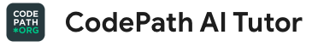
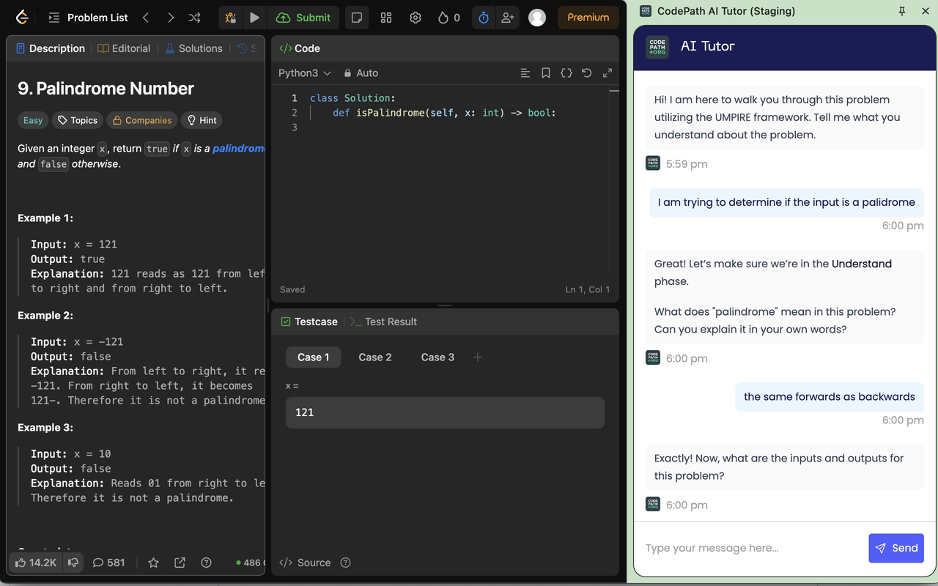

How do I get the most out of this course?
Build your skills with support! Take the following steps:
Install the AI Tutor on chrome: https://go.codepath.org/tiptutor
Solve 2 LeetCode problems on 2 different days
Once you’ve taken the steps above, unlock a new opportunity!
+1 absence back for completion(one-time offer)
Take a look at the FAQ if you have any questions
Notes:
🌟 Purpose: Show the new CodePath AI Tutor.
✅ What should I be doing?
Encourage the use of the new AI Tutor: https://go.codepath.org/tiptutor
Specifically for use with LeetCode problems
🎙️ What should I be saying?
It’s common to get stuck on a difficult problem when practicing independently. Try using the AI Tutor as a way to get unstuck, guiding you through the UMPIRE method for the problem.
🙌🏽 How should I engage students?
Complement your additional practice with the support and guidance from the AI Tutor.

